Slide 1
Video Based Reconstruction of 3D People Models
Thiemo Alldieck, Marcus Magnor, Weipeng Xu, Christian Theobalt,
Gerard Pons-Moll
Computer Graphics Lab, TU Braunschweig, Germany
Max Planck Institute for Informatics, Saarland Informatics Campus, Germany
(CVPR 2018 Spotlight)
朴智新
2018年8月25日

Slide 2
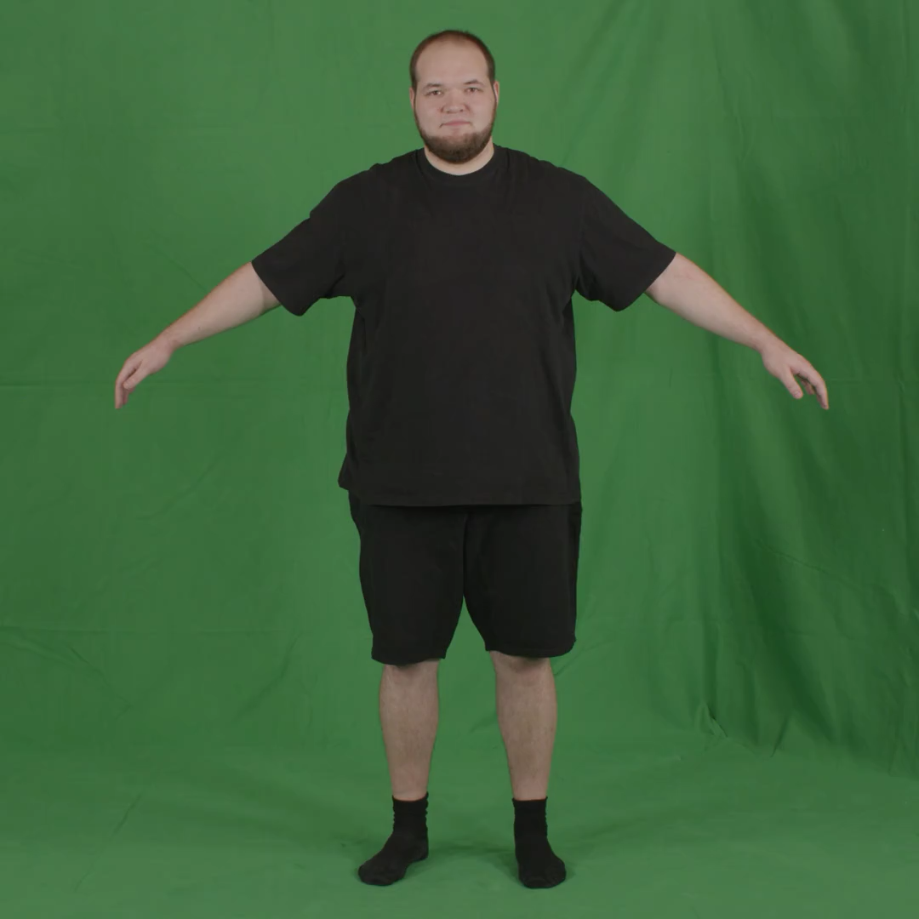
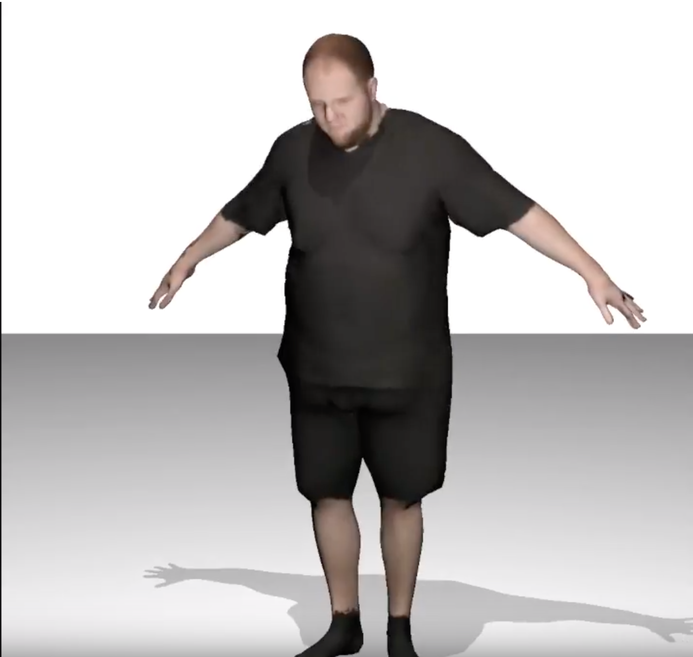
What is Reconstruction of 3D People?

Slide 3
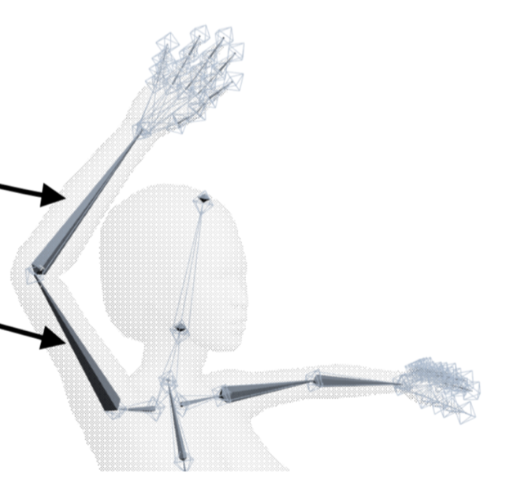
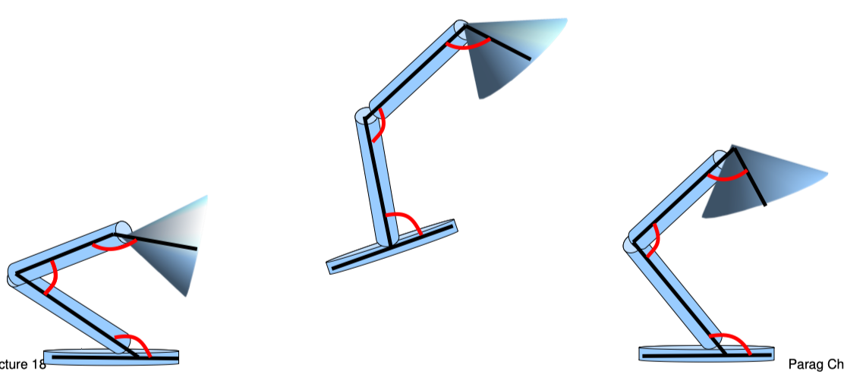
Something you need know...
skeleton
Pose

Slide 4
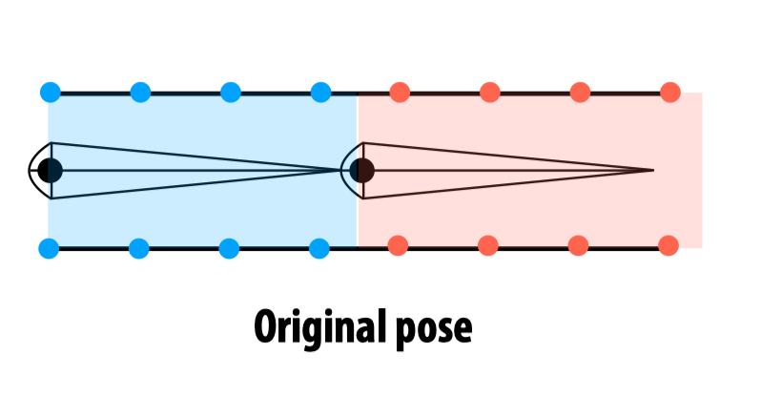
Something you need know...
Binding

Slide 5
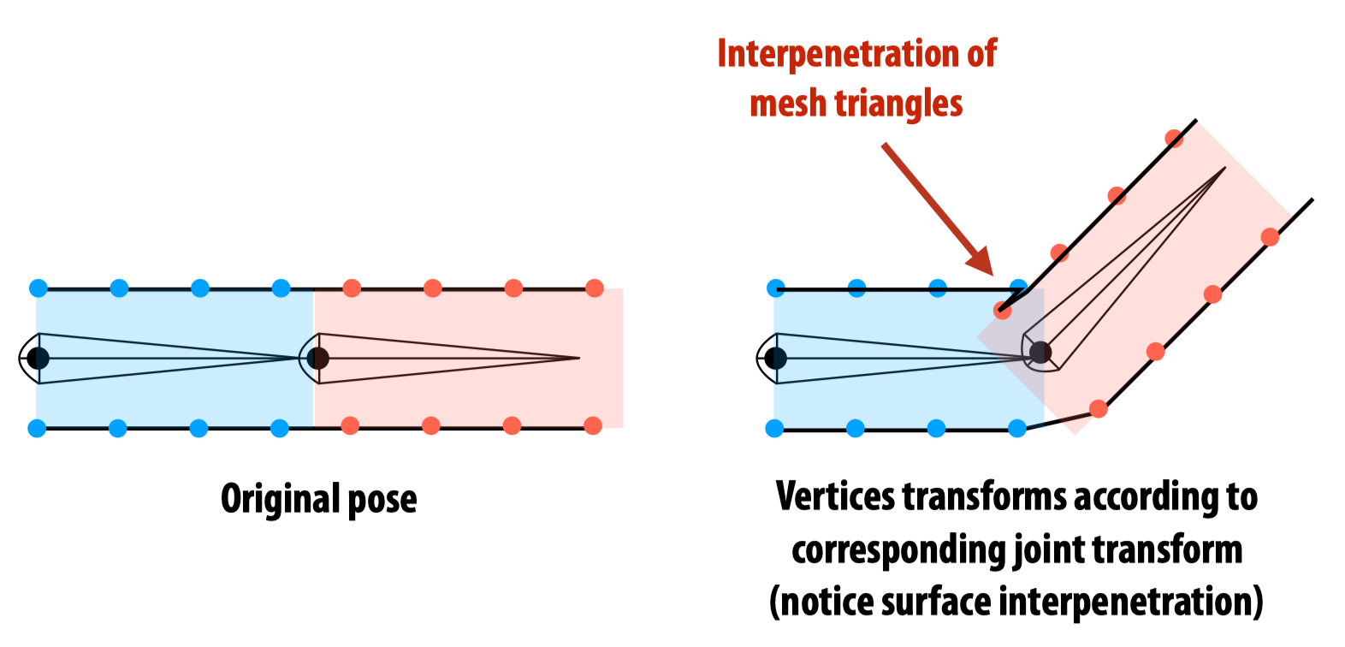
Something you need know...
Rigid body skinning
transform mesh vertices according to transform for nearby skeleton joint

Slide 6
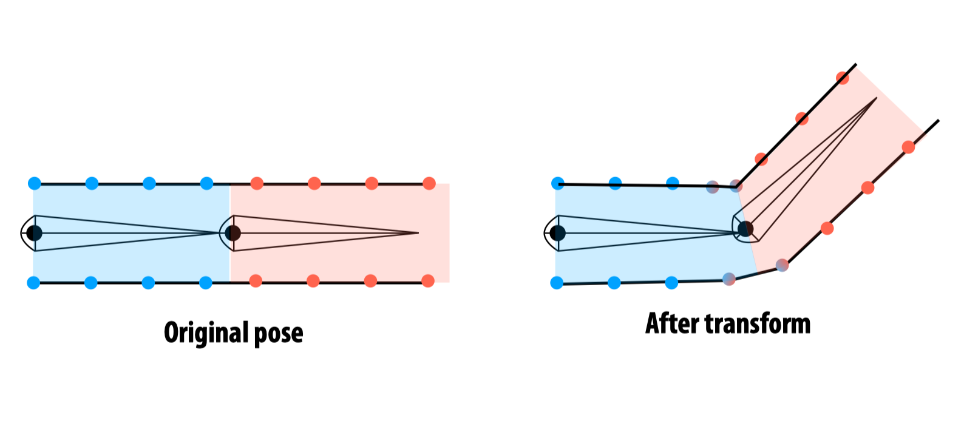
Something you need know...
Linear blend skinning
Transform mesh vertices according to linear combination of transforms for nearby skeleton joint

Slide 7
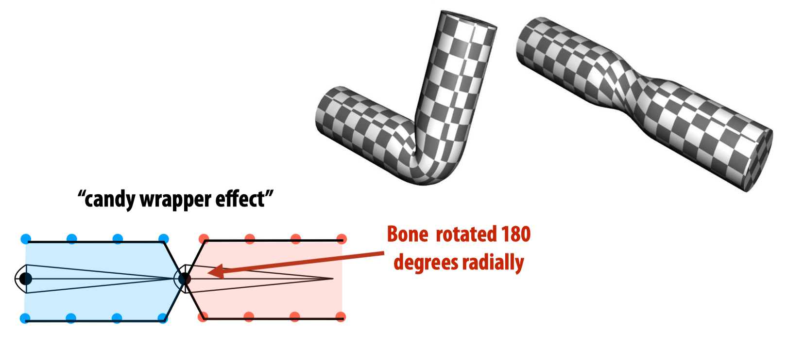
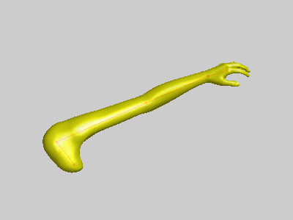
Something you need know...
Shortcomings of linear blend skinning

Slide 8
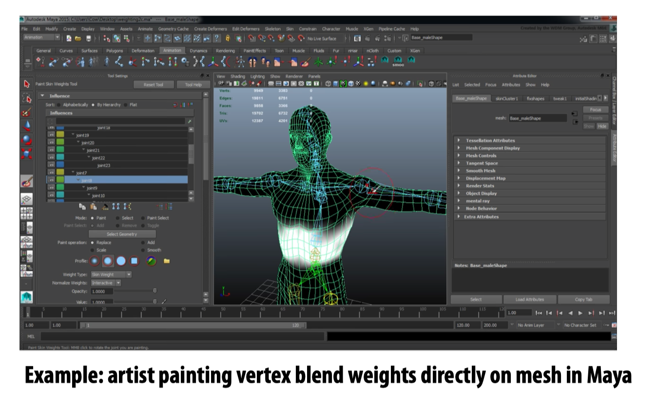
Something you need know...
“Rigging” is the process of attaching a set of animation controls to a mesh - In the case of linear blend skinning: it is attaching a skeleton to the mesh
rigging = build skeleton + binding + skinning

Slide 9
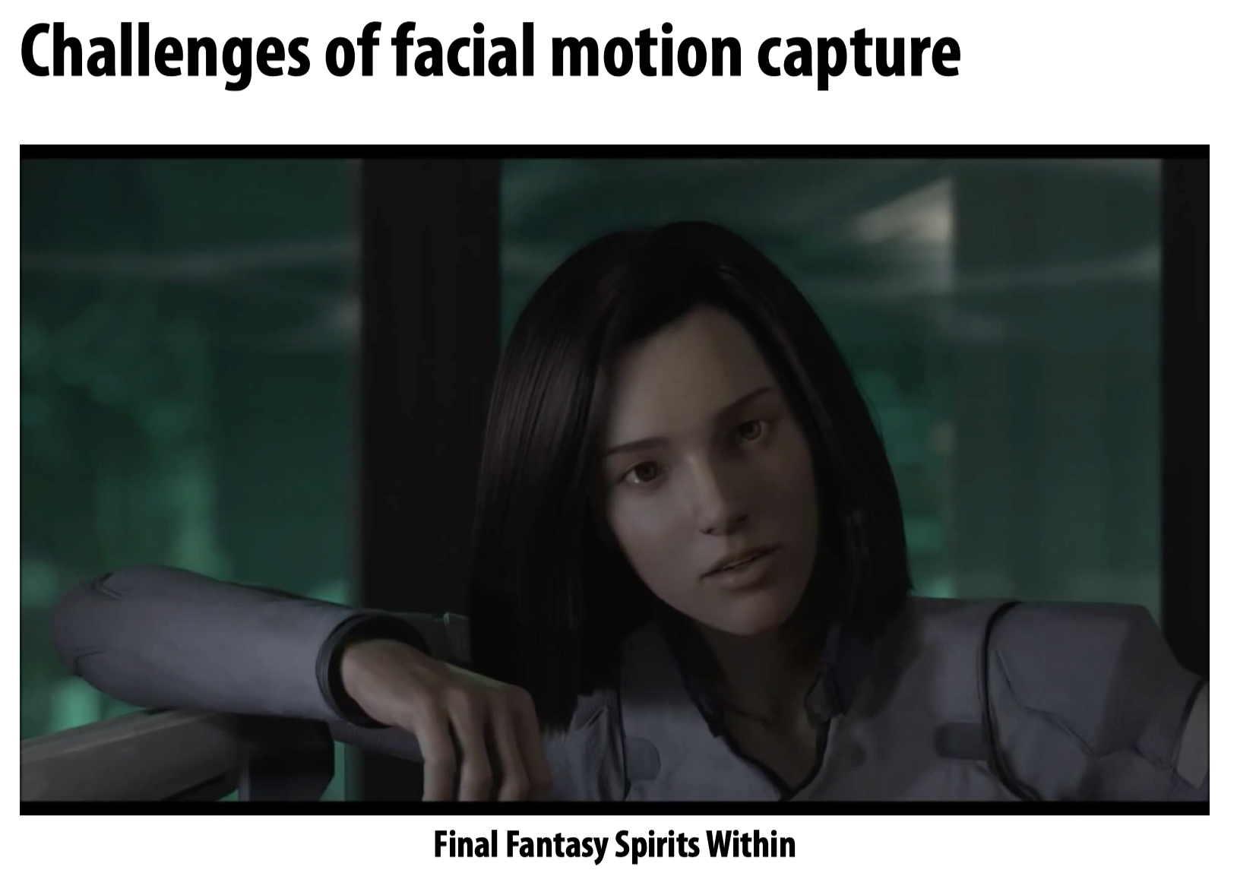
Something you need know...

Slide 10
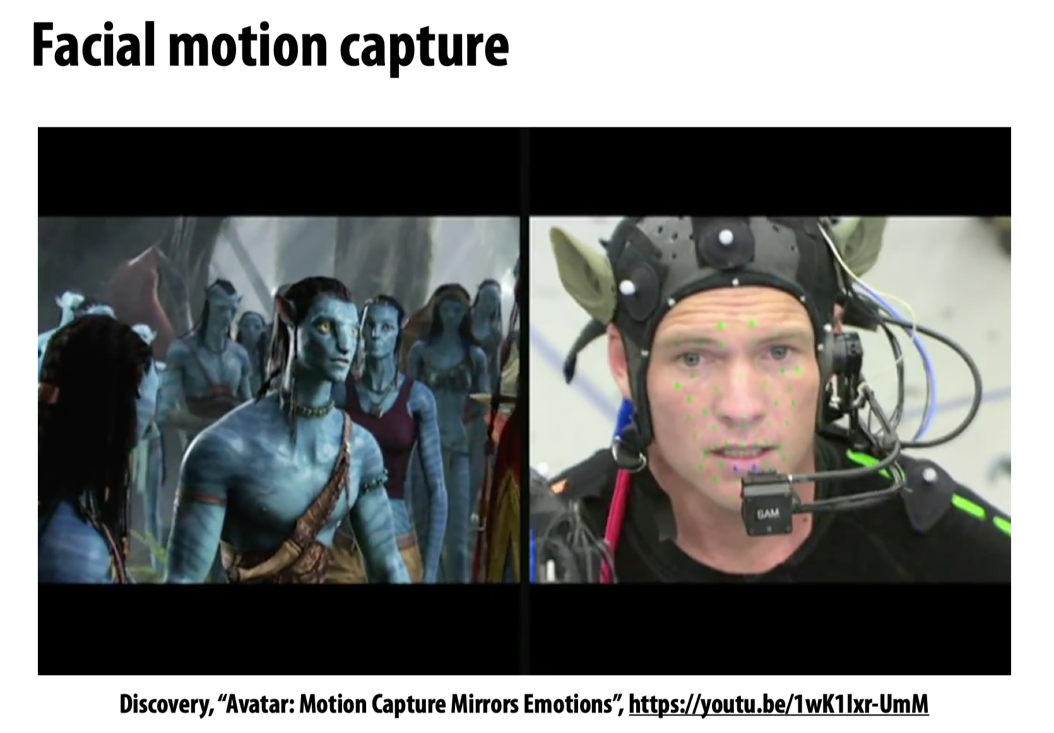
Something you need know...

Slide 11
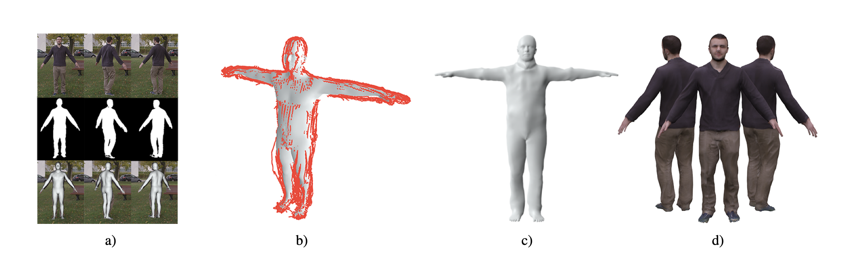
Overview
We ﬁrst calculate poses using the SMPL model
Then we unpose silhouette camera rays (unposed silhouettes depicted in red)
optimize for the subjects shape in the canonical T-pose
Finally, we are able to calculate a texture and generate a personalized blend shape model

Slide 12
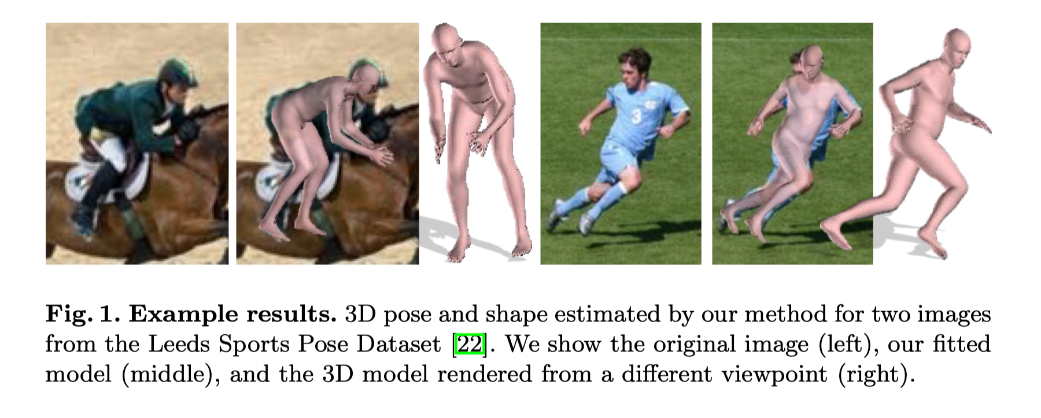
SMPLify

Slide 13
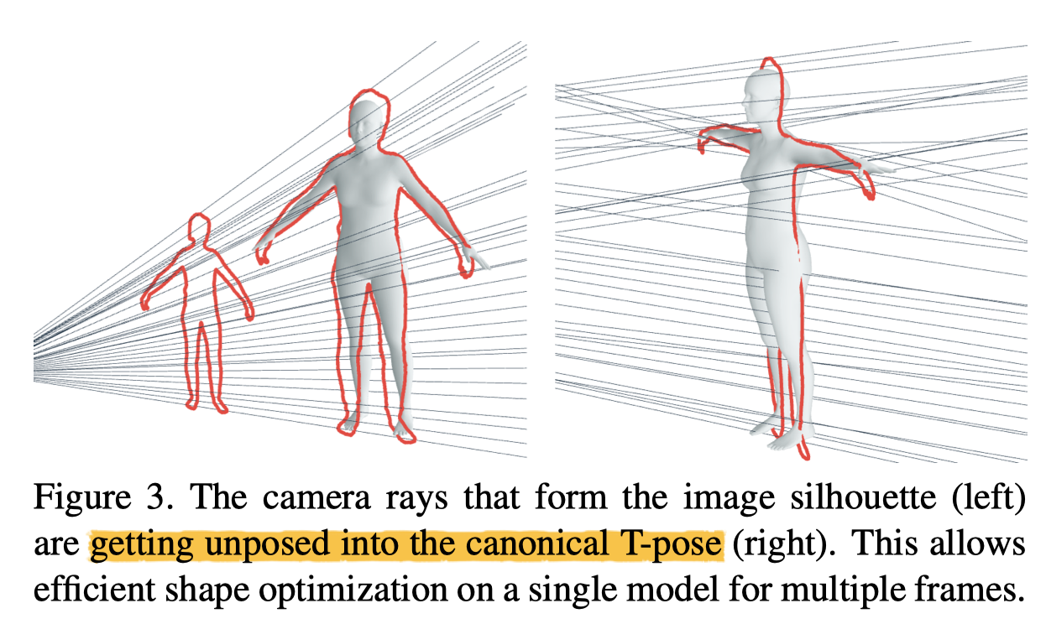
Unpose

Slide 14
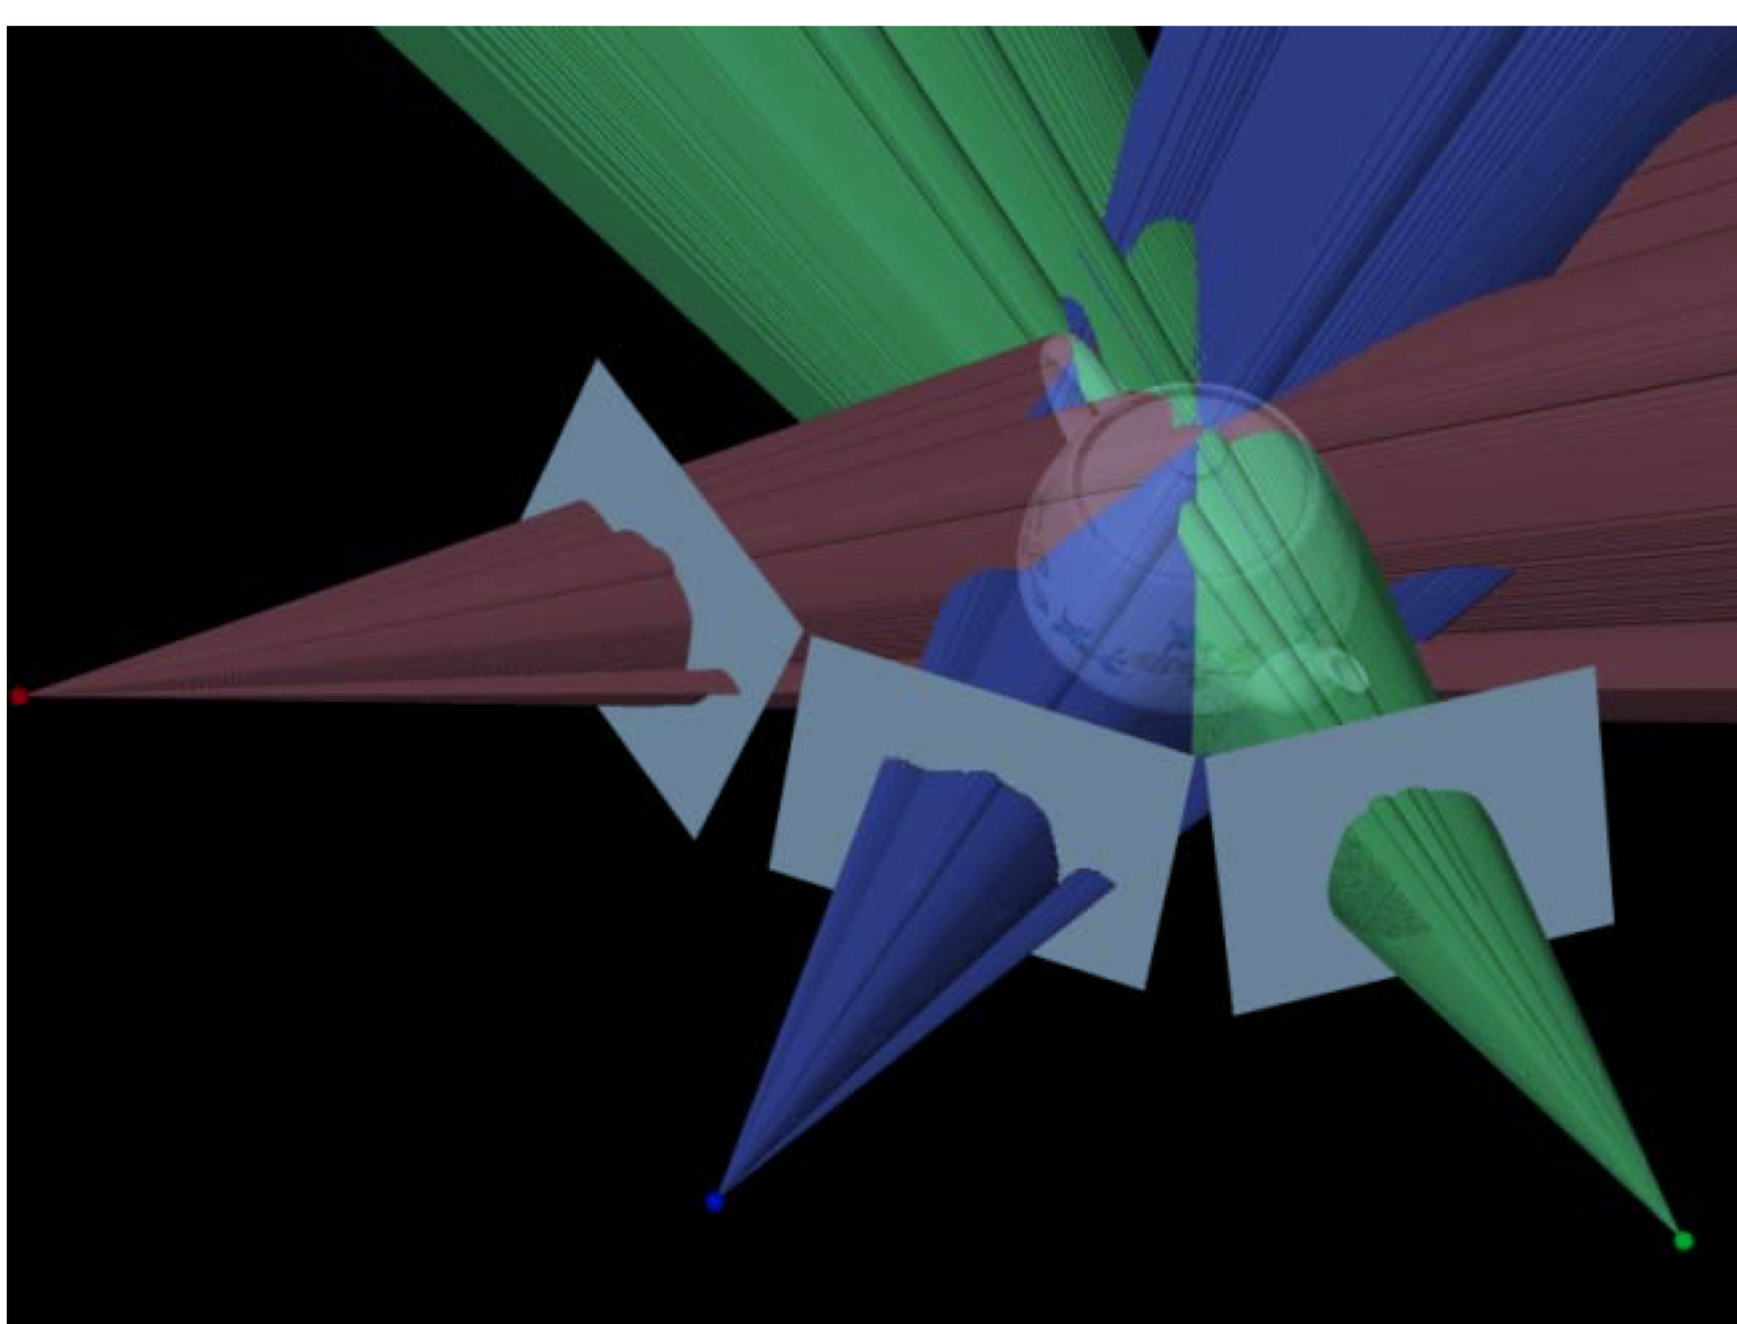
Visual Hull

